Slide 2
Infrastructure as code with Terraform, Ansible and ARM

Slide 3
Agenda
Pre-Day Overview
Infrastructure as Code
Labs
Challenges
Wrap-up

Slide 4
Infrastructure as Code
A key DevOps practice
It’s management of infrastructure (networks, virtual machines, load balancers, and connection topology) in a descriptive model, using the same versioning as DevOps team uses for source code
Used in conjunction with other key DevOps principles such as Continuous Integration and Continuous Delivery

Slide 5
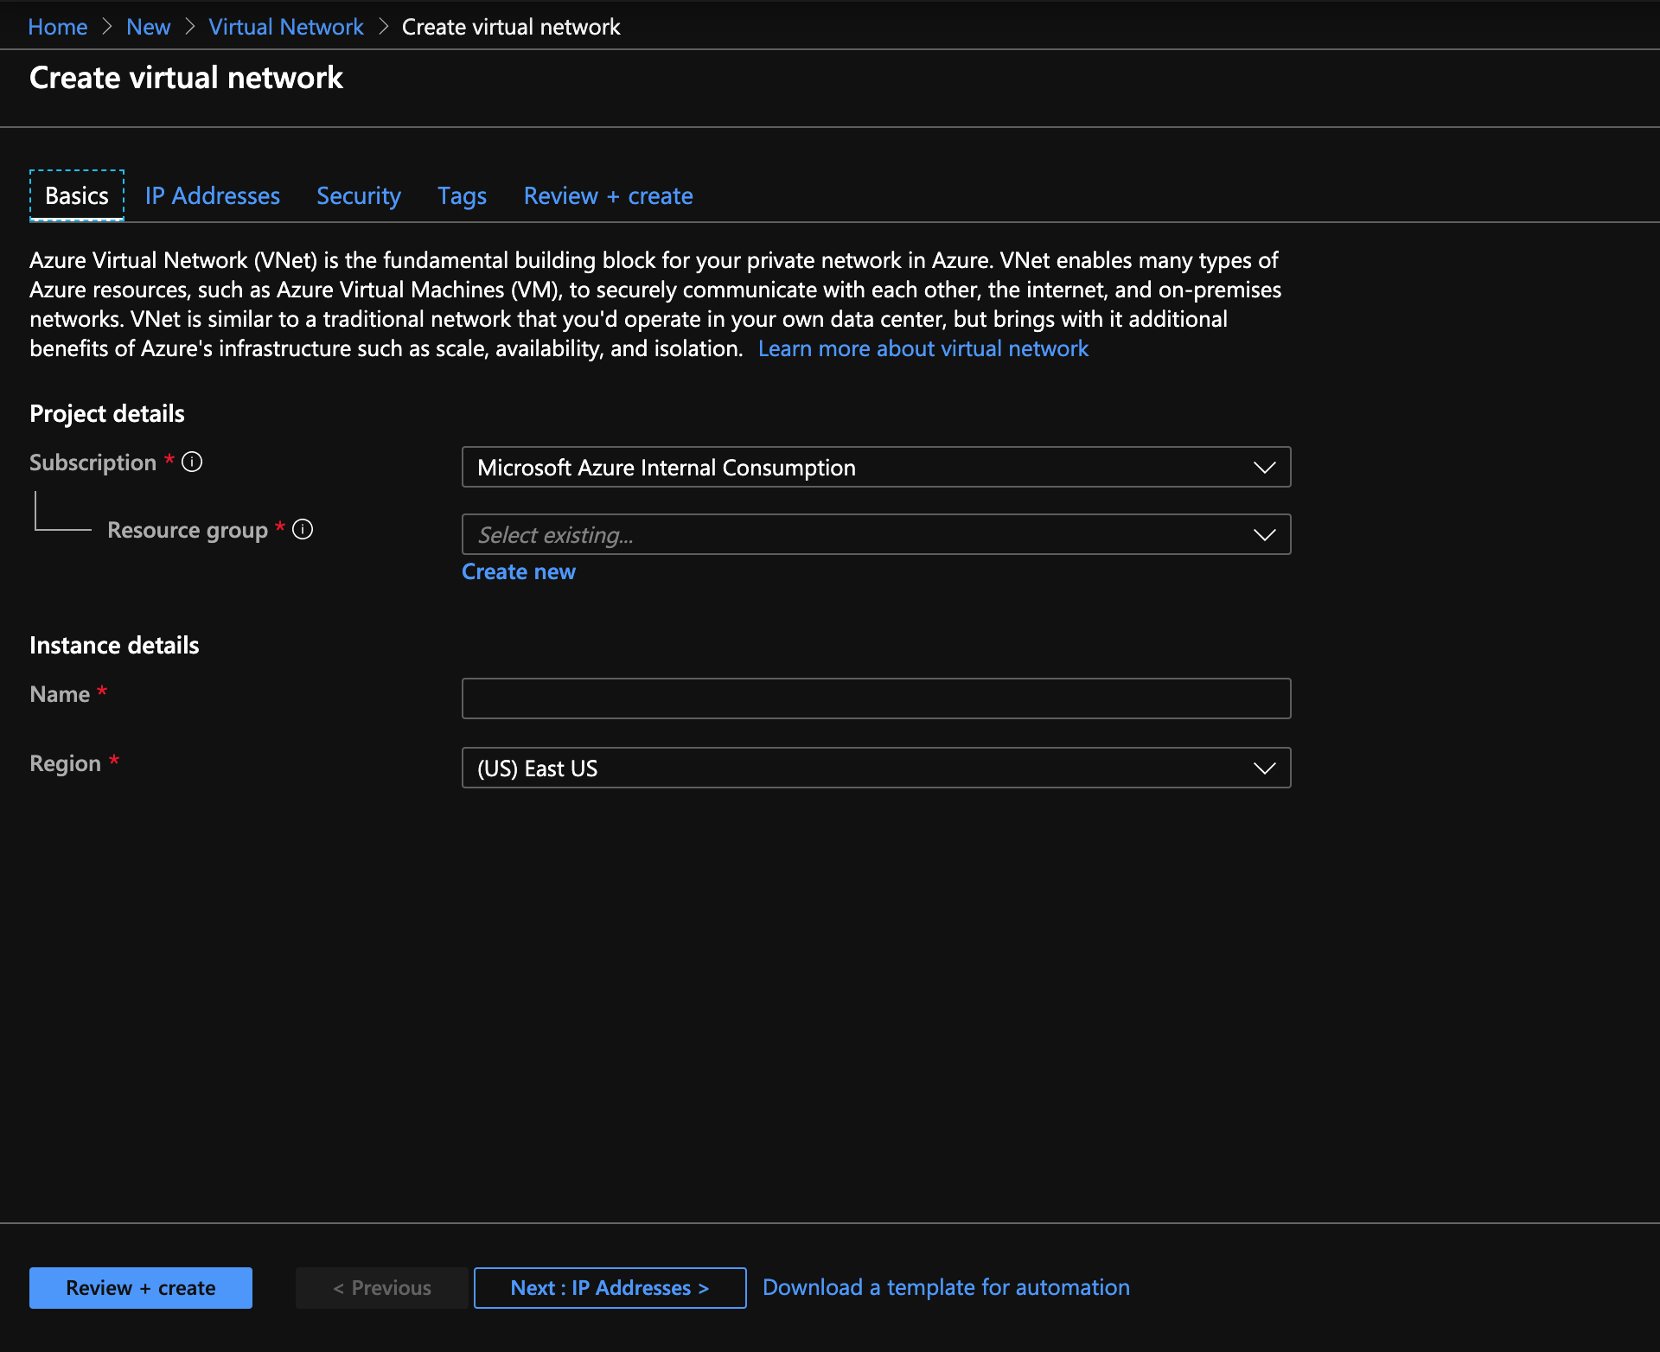
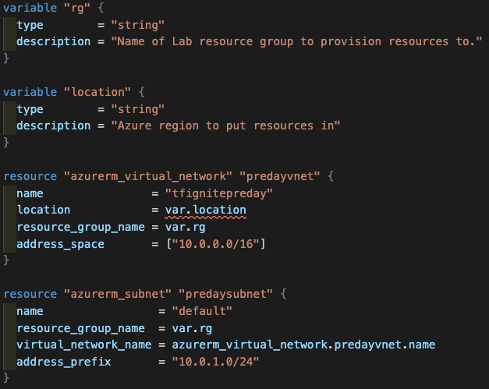
Infrastructure as Code
Instead of this this

Slide 6
IaC as a Key Component of Modern DevOps
People
Process
Business Value
...
200 level Practices
Infrastructure as Code
Continuous Integration
Continuous Delivery
300 level Product + Practice
ARM Template with Azure Website + SQL DB
100 level Overview
Terraform Deploying Linux VM on Azure
Az DevOps (git) + Jenkins (build)
Github + Az DevOps Pipelines (build)

Slide 7














DevOps on Azure framework
Plan and track
Code
Build and test
Deploy
Operate
Monitor
Boards
(Azure DevOps)
Repos
(Azure DevOps)
Pipelines & Test Plans
(Azure DevOps)
Artifacts & Pipelines
(Azure DevOps)
Policy
Application
Insights
GitHub
Trello
GitHub
Jenkins
Terraform
Ansible
ELK Stack

Slide 8



























Azure Supports the Open Source Ecosystem
Management
Databases & middleware
Applications
Infrastructure
Linux
App frameworks

Slide 9
Terraform
OVERVIEW

Slide 10
HashiCorp Partnership
Multi-year agreement with HashiCorp for collaboration on Terraform providers for Azure
Public milestones and regular release cadence
Tracked publicly in GitHub at
http://github.com/terraform-providers/terraform-provider-azurerm
Releases occur every 3 weeks
Dedicated Azure engineering team
Documentation & tutorials
https://docs.Microsoft.com/azure/terraform
https://learn.hashicorp.com/terraform?track=azure#azure
Microsoft 1st line Support
V-team of MS PMs and engineers with HashiCorp engineers
Microsoft PM owns prioritization of incoming customer issues

Slide 11






Multi-cloud infrastructure transition
TRADITIONAL DATACENTER
HYBRID DATACENTER
Application Platform
Security
Private cloud
AWS
Azure
GCP
Core Infrastructure
(Reproduced with permission from Hashicorp)

Slide 12
Infrastructure as Code
Reproducible Environments
Automation – CI/ CD
Trackable – GitHub
Language - HCL
Workflow
Providers
Apply same config across clouds

Slide 13
Providers
Defines how Terraform will interact with:
Cloud
Azure
AWS
Google
AliCloud
OpenStack
Infrastructure
Kubernetes
Docker
Rancher
Network
DNS
Cloudflare
HTTP
Version Control
GitHub
GitLab
Bitbucket
Monitoring
DataDog
Grafana
PagerDuty
Database
InfluxDB
MySQL
PostgreSQL
Etc.

Slide 14

Resources & Data Sources
This Photo by Unknown Author is licensed under CC BY-SA-NC

Slide 15
Workflow
Init
Plan
Apply
Destroy

Slide 16
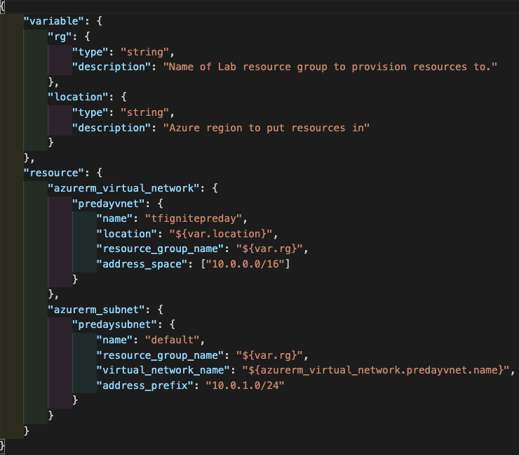
Configuration Syntax
HCL 0.12
JSON

Slide 17


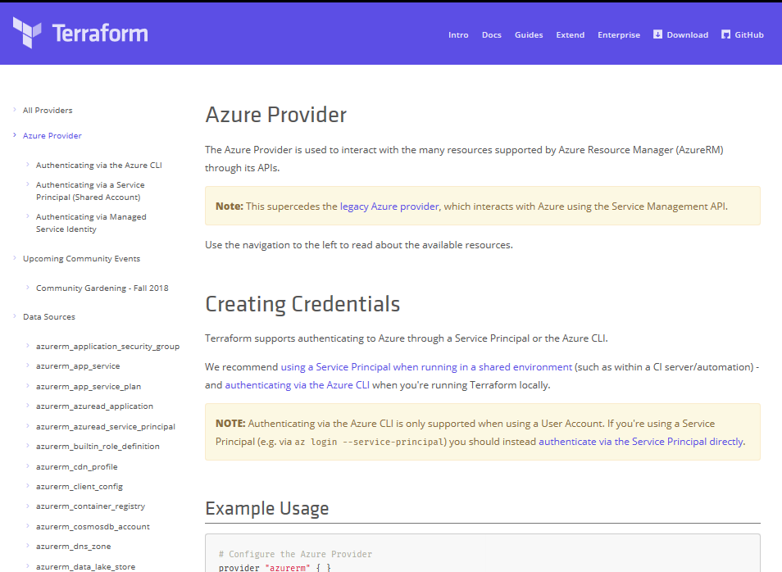
Terraform
Azure DevOps Tool Integrations
Bringing native Azure support for customers using Terraform
Documentation Hub for Terraform
Terraform in Azure Cloud Shell
Azure Resource Provider
Azure Module Registry
Azure Cloud Shell Integration
➔
docs.microsoft.com/azure/terraform
© Microsoft Corporation

Slide 18
Ansible
OVERVIEW

Slide 19
What is Ansible?
Open Source Configuration Management and Automation Tool
SIMPLE
POWERFUL
AGENTLESS
Human readable automation
No special coding skills needed
Tasks executed in order
Usable by every team
Get productive quickly
App deployment
Configuration management
Workflow orchestration
Network automation
Orchestrate the app lifecycle
Agentless architecture
Uses OpenSSH & WinRM
No agents to exploit or update
Get started immediately
More efficient & more secure
* Based on Quickstart video on https://docs.ansible.com

Slide 20
Ansible language basics
Playbooks contain plays
Plays contains tasks
Tasks call modules
Tasks run sequentially
Handlers are triggered by tasks,
And are run once, at the end of the plays
* Based on Quickstart video in https://docs.ansible.com

Slide 21
Ansible Playbooks
Plain-text YAML files that describe the desired state of something
Kept in source control
How to run?
ansible-playbook myplaybook.yml
Check mode – dry-run
ansible-playbook –C myplaybook.yml
# Description
# ===========
# This playbook creates a resource group in Azure
- name: Create Azure resource group
hosts: localhost
connection: local
vars:
resource_group: testResourceGroup
vm_name: testVM
location: eastus
tasks:
- name: Create a resource group
azure_rm_resourcegroup:
name: "{{ resource_group }}"
location: "{{ location }}"

Slide 22
Modules
Controls the thing you are automating
idempotent; check-mode enabled
Over 160+ Azure modules:
https://aka.ms/ansiblesupport
https://docs.ansible.com/ansible/latest/modules/list_of_cloud_modules#azure
Documentation:
ansible-doc azure_rm_resourcegroup
ansible-doc -l

Slide 23
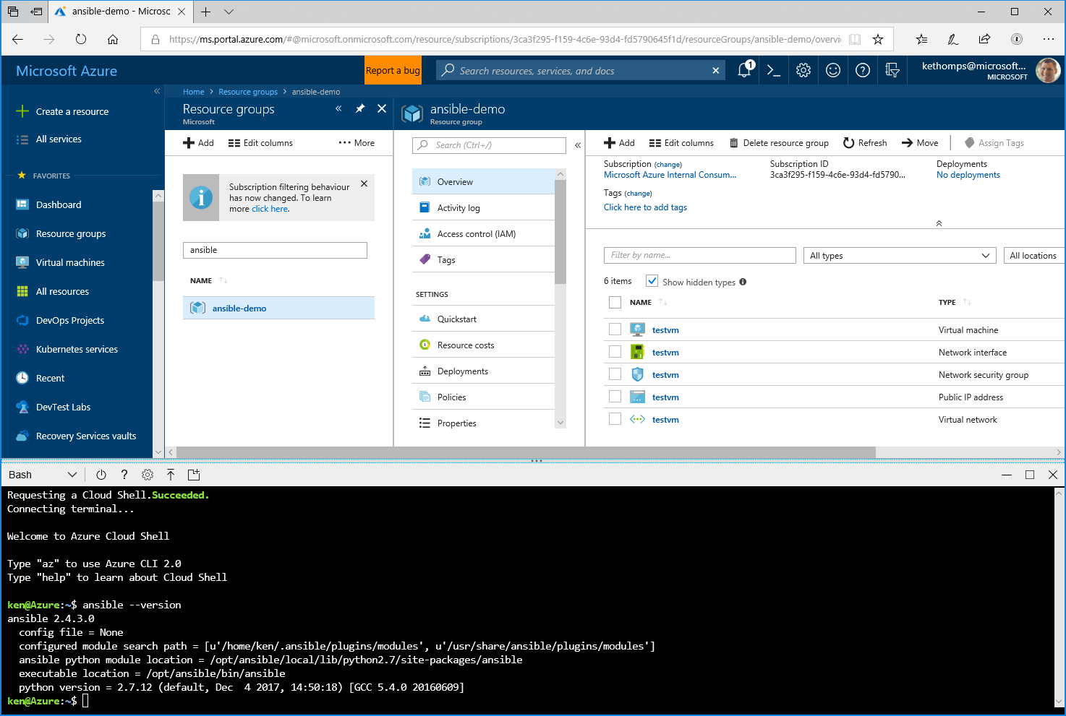
Azure Cloud Shell
Browser-based shell experience for Ansible
Bash and PowerShell environments that are pre-authenticated to your Azure services
No need to set up/install control node
Availability of other developer and administrative tools
Integrated editor: code .
More details at https://cda.ms/9S

Slide 24
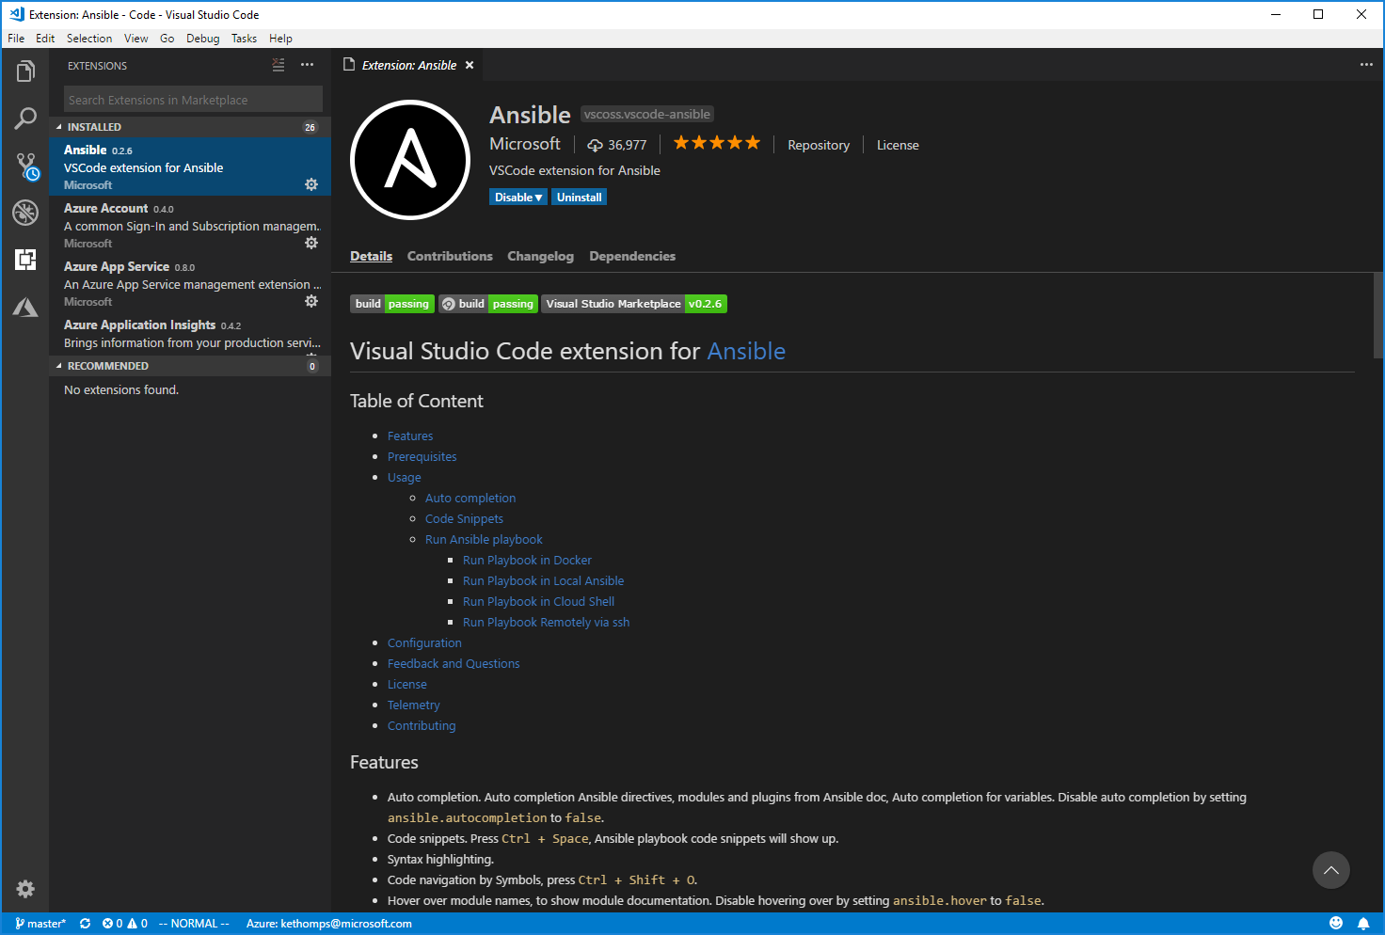
Visual Studio Code
Ansible Extension
Runs everywhere
Features of the Ansible extension
Auto completion
Code snippets
Syntax highlighting
Auto file copy to remote host on saving
Run playbook:
In Cloud Shell
In Docker
In local Ansible installation
Remotely via ssh
Download Visual Studio Code from https://cda.ms/9T
Download the Ansible Extension from the Extension panel in VS Code or https://cda.ms/9V

Slide 25
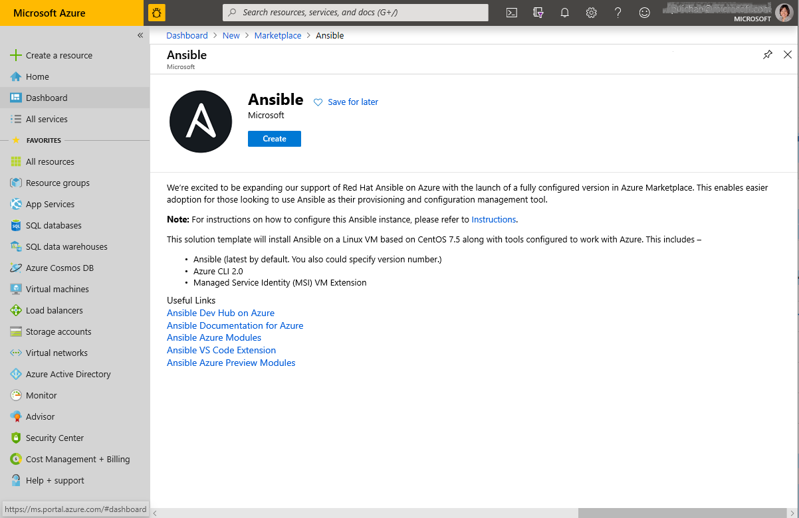
Azure Marketplace & Documentation Hub
Official guidance
Ansible in Azure Marketplace
https://aka.ms/ansibleaz
Ansible on a Linux VM based on CentOS 7.5
Ansible (latest by default.)
Azure CLI 2.0
Managed identities integration
Ansible Dev Hub on Azure
https://aka.ms/ansible
Documentation hub dedicated to Ansible + Azure
Quickstarts
Tutorials
Support matrix
Releases and Features

Slide 26
Azure Resource Manager (ARM) Templates
OVERVIEW

Slide 27

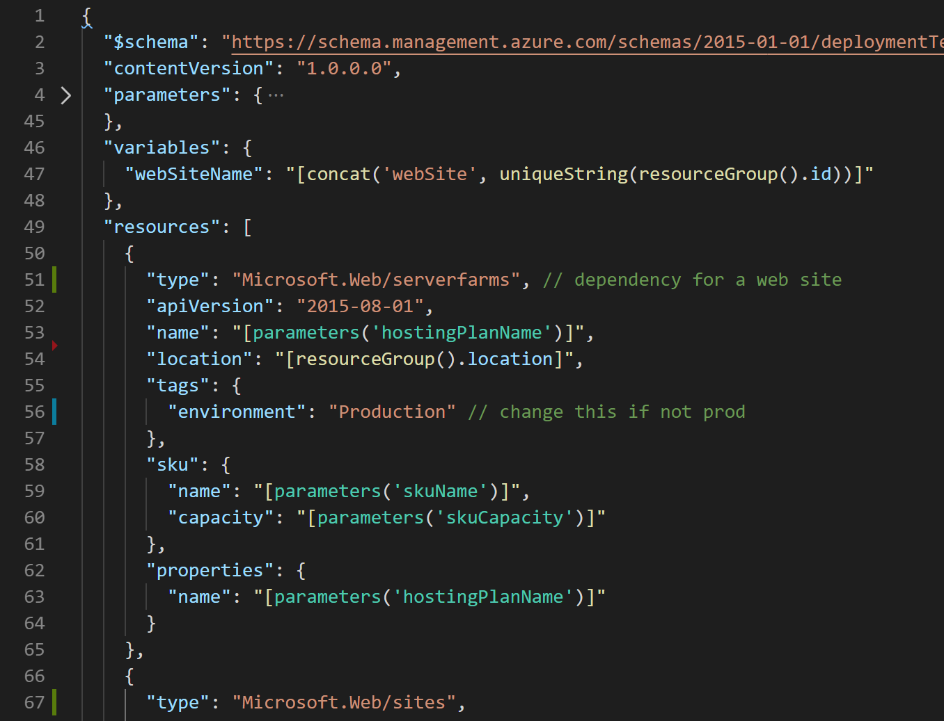
What are ARM Templates?
Declarative code for describing Azure resources.
JSON meta-language. Thin layer over the ARM REST API
Can use parameters, variables, and outputs
Support for expressions, functions, looping, conditions
Can use // or /* */ comments and multi-line strings

Slide 28
Benefits of using ARM Templates
Pre-Flight Validation
1
ARM Templates
Non-template based infra as code
ARM Deployments have pre-flight checks to make sure the template will deploy successfully
Deployments are a tracked resource in the ARM API
2
Logs all details of the deployment — status, resources deployed, the original template, outputs, etc.
One ARM Template submitted
Multiple Imperative PUT Calls
Resource Provider coverage from day one
3
When a new Azure Resource is released (even a private preview), you can use it in an ARM template
ARM
Building block for key services
4
Resource Providers
(e.g. Microsoft.Compute)
Policy remediation, blueprints, managed applications all take a dependency on ARM templates
Services
(e.g. Virtual Machine)

Slide 29
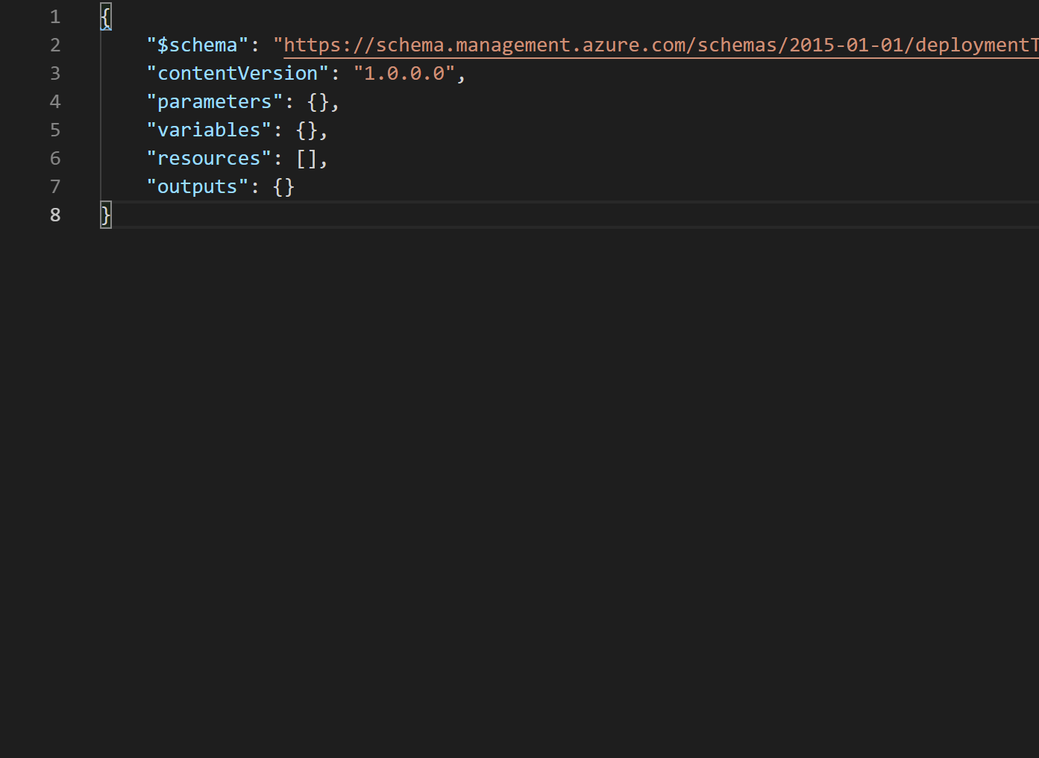
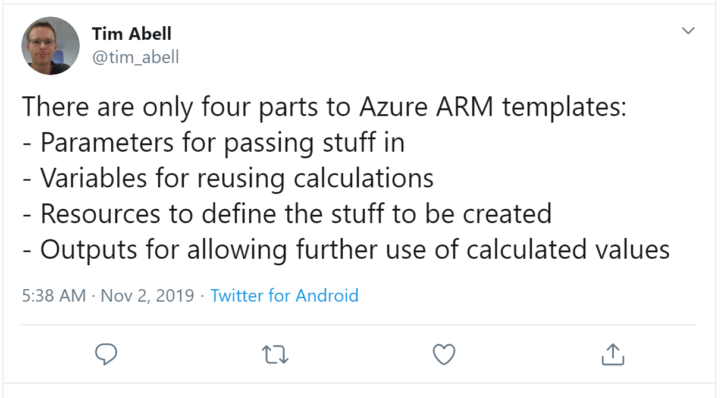

Slide 30
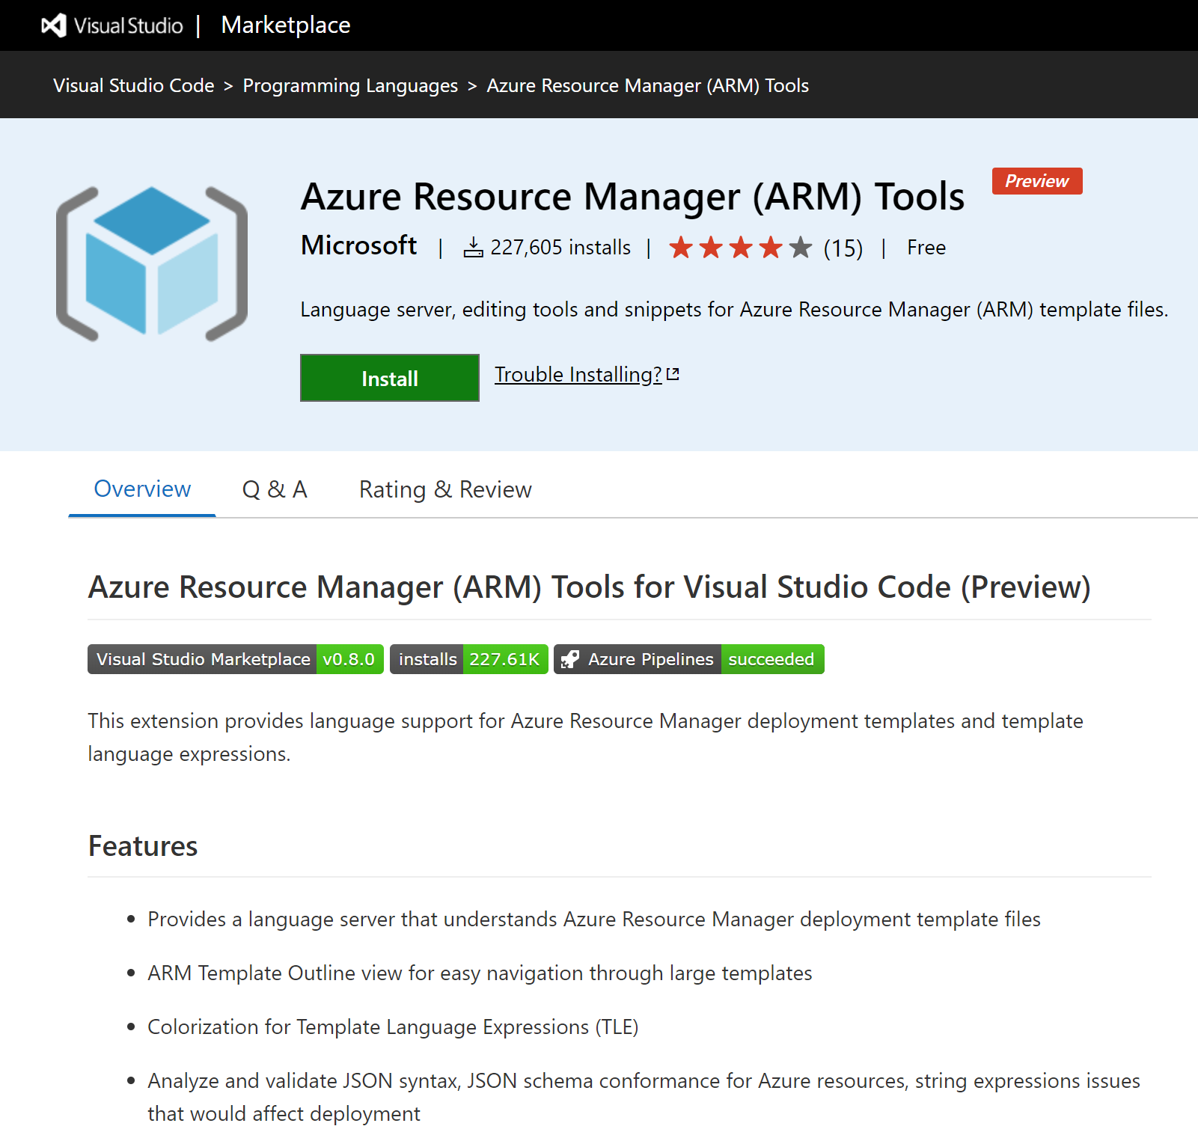
VS Code Extension for authoring
Syntax highlighting
Snippets
IntelliSense and Type Completion
Reduced false positives

Slide 31
Walk-throughs

Slide 32
Lab 1 – Basic

Slide 33
Description
Virtual Network
You will use Ansible/ARM Templates/Terraform to create the fundamental building block of Azure infrastructure - a virtual network.
Virtual network (or VNet for short) enables many types of Azure resources, such as virtual machines, to communicate securely with each other, the internet and on-premises network.
Subnet

Slide 34



Demos
Ansible
ARM Template
HashiCorp Terraform

Slide 35
Lab Access URL: https://aka.ms/ignite-PRE04 Activation Code: IGNITE1007
Need help? Raise a Flash Card
Blue for Terraform
Green for ARM Templates
Red for Ansible
Demo Wifi:
DEMOWIFI
Msdemo2019x
Storage accounts must be all lowercase, start with a letter, can only be letter or numbers (no underscores/dashes), must be globally unique
WhatIf modules can be downloaded from:
https://aka.ms/wi - unzip into c:\whatif
ARM Lab VM Parameters File == TemplateParametersFile
aka.ms/IgniteMeetup

Slide 36
Lab 2 - Variables

Slide 37

Description
Virtual Network
You will build upon the infrastructure (VNet + subnet) you created earlier by creating a virtual machine and adding a network interface to it to allow that virtual machine to communicate with the outside world. You will also learn how to define and use variables inside your code to parameterize resources.
Subnet

Slide 38
Demos
Ansible
ARM Template
HashiCorp Terraform

Slide 39
Lab 3 – Iteration & Helpers

Slide 40
Description
Virtual Network
You will secure this infrastructure while learning how to use iterators and helper functions. You will simulate a common scenario in cloud infrastructure where you have infrastructure tiers, such as database tier, backend tier, and a web tier, all with their own set of security policies.
Subnet 1
Subnet 2

Slide 41
Demos
Ansible
ARM Template
HashiCorp Terraform

Slide 42
Lab 4 – Reusability

Slide 43

Description
In any real-world Infrastructure as Code project, you will have secrets such as tokens, passwords, connection strings, certificates, encryption keys, etc. that are required in order to provision the desired resources. You will create a secret that will be stored in Azure Key Vault and grant the end user or process permission to the secret. You will then reference and use the secret stored in Azure Key Vault in your configuration.
Virtual Network
Subnet 1
Subnet 2

Slide 44
Demos
Ansible
ARM Template
HashiCorp Terraform

Slide 45
Lab 5 - Security

Slide 46
Description
In this section you will create a reusable component from the configuration that you have been working on in previous labs. This component is a way to package up a configuration for easy reuse. The result will be something that can be used to create a VM with an associated subnet and a relevant security group with appropriate rules. Typically this modularizing also allows including business best practices, defaults, etc.
Subnet 2
Subnet 2
Subnet 2
Subnet 2

Slide 47
Demos
Ansible
ARM Template
HashiCorp Terraform

Slide 48



Challenge 1

Slide 49








1 hour
1 challenge
Proctor
Score
AKS Cluster
Web App & DB
Image Gallery
CI/CD
https://aka.ms/iac_challenges

Slide 50
Challenge 2

Slide 51
1 hour
1 challenge
Proctor
Score
AKS Cluster
Web App & DB
Image Gallery
CI/CD
https://aka.ms/iac_challenges

Slide 52
Wrap-up

Slide 53
Ansible
Wrap-up

Slide 54
When creating a playbook
What’s your overall scenario?
What do you need?
What’s available?
native support (aka. modules)
azure_preview_modules
What’s not?
What do you do when there is a gap?

Slide 55
Azure Resource Manager (ARM) template
Use azure_rm_deployment to create or destroy ARM template via the Azure SDK for Python
Pros
Latest and greatest (preview feature)
Cons
Idempotency is not guaranteed
Could be hard to debug
Recommendations
One template for one resource group
Use azure_rm_deployment_info
Samples: Quickstart template
# Create a simple Ubuntu VM
- name: Create Azure
azure_rm_deployment:
resource_group: "{{ resource_group }}"
location: "{{ location }}"
template_link: 'https://raw.githubusercontent.com/Azure/azure-quickstart-templates/master/101-vm-simple-linux/azuredeploy.json’
parameters:
authenticationType:
value: "password"
adminUsername:
value: "{{ admin_user }}"
adminPasswordOrKey:
value: "{{ admin_password }}"
dnsLabelPrefix:
value: "{{ name }}"
ubuntuOSVersion:
value: "16.04.0-LTS"

Slide 56

Azure REST API
Azure DevOps Solution Page (Unaware > Beginner)
“Meetup in a Box” (Beginner> Expert)
OSS Community Incubation (Expert)
Use azure_rm_resource to create, update or delete any Azure resource using Azure REST API
Refer to https://docs.microsoft.com/en-us/rest/api/
Idempotency is not 100%
If enabled: done by using GET method and compare with body
Recommendations
Use for “patching”
Use azure_rm_resource_info
using uri module to interact with webservice is not recommended
# Use REST API to create a network security group
- name: Call REST API
azure_rm_resource:
api_version: '2018-02-01'
resource_group: "{{ resource_group }}"
provider: network
resource_type: networksecuritygroups
resource_name: "{{ nsgname }}"
body:
location: "{{ location }}"
idempotency: yes

Slide 57
Collection
A new Ansible content distribution format
Ansible 2.9 → 18 certified Azure modules have been moved to azure.azcollection
What does this mean to you?
More frequent update
Need to install collection
Need to specify the fully qualified collection name (FQCN)
- hosts: all
collections:
- my_namespace.my_collection
tasks:
- import_role:
name: role1
- mymodule:
option1: value
- debug:
msg: '{{ lookup("my_namespace.my_collection.lookup1", 'param1')| my_namespace.my_collection.filter1 }}'

Slide 58
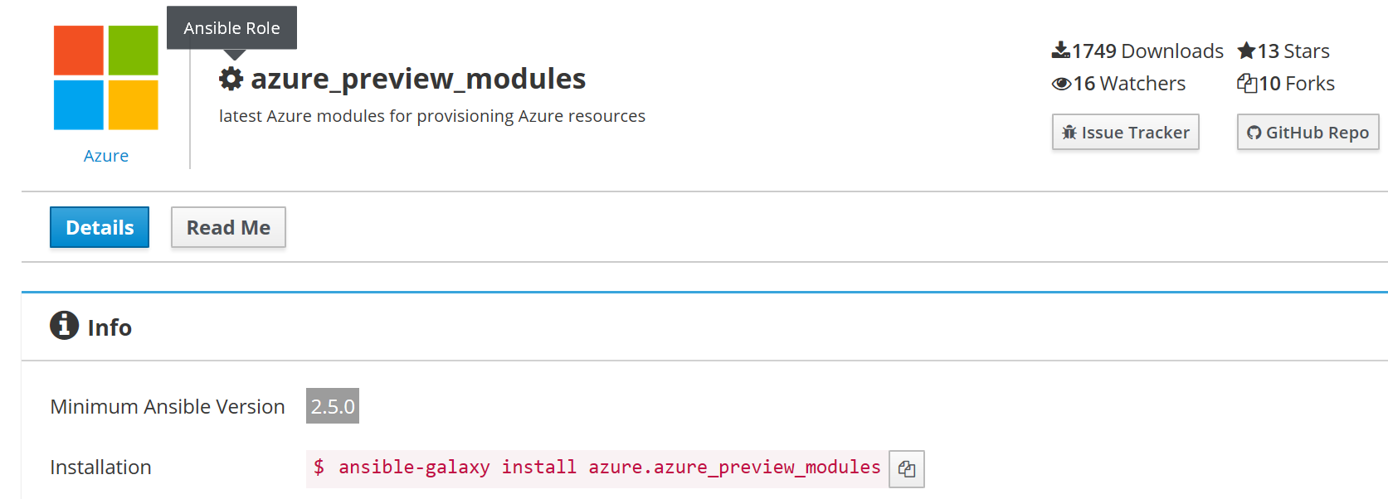
Ansible
New Ansible modules in Ansible 2.9 (Oct 31, 2019)
18 certified modules moved to azcollection
Shared Image Gallery
Snapshot
Specialized image support
Azure Automation account
Azure Batch account
Azure Fire Wall
Azure IoT
Azure Lock
Future (influenceable!)
Move all modules to azcollection
New modules
Management group; subscription
Azure policy, Azure Blueprints
OpenShift
Azure Frontdoor
Enhanced support:
Enhanced VM/VMSS support: ephemeral disk
VS Code extension (WSL 2)
Enhanced VM/VMSS
Support
Try something new?
The Azure Preview Module role allows the user to preview new Azure modules before they are merged upstream.
https://galaxy.ansible.com/Azure/azure_preview_modules

Slide 59
ARM Templates
Wrap-up

Slide 60
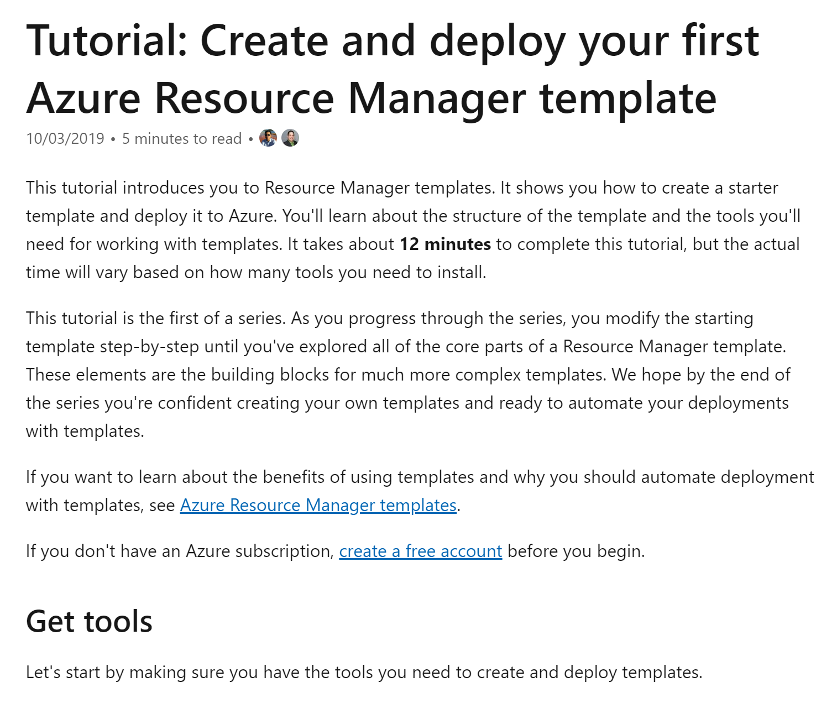
Redesigned 101 tutorial
aka.ms/justLearnARM

Slide 61
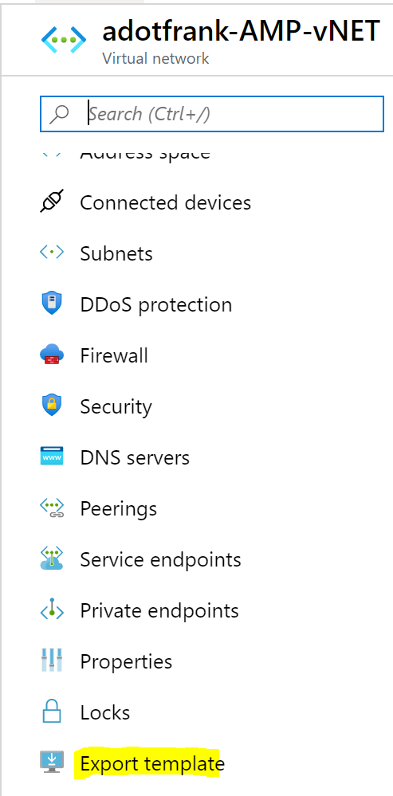
Resources for finding new ARM templates
ARM Template QuickStart Repo:
https://github.com/Azure/azure-quickstart-templates
Export ARM Templates from Azure:
https://docs.microsoft.com/azure/azure-resource-manager/export-template-portal
Official ARM Template Reference:
https://docs.microsoft.com/azure/templates/

Slide 62
New stuff at Ignite this week!
BRK3233 – “What’s new with ARM Templates for your deployments”
What-If: Preview your ARM Template deployments before execution
Deployment Script resource type: Execute arbitrary powershell or bash code in a template
Overhauled VS Code extension: better IntelliSense, snippet support
Friday, 9:15-10:15AM, W415 C-D

Slide 63
HashiCorp Terraform
Wrap-up

Slide 64
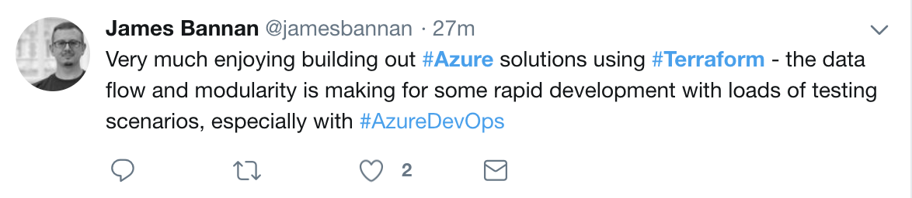

Terraform Investments & Improvements
Add new Terraform resources
Build higher level modules
Grow healthy OSS Community
Type | V1.0.0 (1/2018) | Latest (8/2019)
Total Resources | 97 | 286
Total Data Sources | 14 | 84
+189
+70

Slide 65
State
Compare configuration to current
Develop plan
Default store – local (terraform.tfstate)
Show
Import

Slide 66
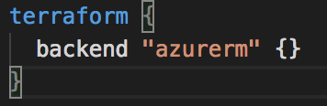
Azurerm backend
Standard Backend with state locking & consistency checking
Azure Storage (Blob)
remote-state.tf .backend.tfvars

Slide 67
Terraform Sessions at Microsoft Ignite 2019
BRK2166 – How to choose the right infrastructure management tool for the job
Azure supports provisioning and managing its cloud infrastructure using a variety of open-source and first-party tools. Although this provides customers with ultimate in flexibility, it can also result in confusion as to which tool to use, and when. In this session we provide you with some guidelines, scenarios, and best practices for choosing ARM, Azure CLI, Terraform, PowerShell, or Ansible.
Tuesday, 11:45-12:30 PM
THR2168 – Lifecycle of a Java app from initial deployment to running in production using Terraform and Ansible
In this session, learn best practices for using open source tools to manage the full lifecycle of your Java applications in an enterprise Kubernetes (AKS) environment. Using configuration and infrastructure-as-code such as Ansible and Terraform, developers can focus on their application code. This demo-heavy session shows developers how to stand up the environment required by their Java application; quickly deploy their application code and move it to production.
Tuesday, 1:15-1:35 PM

Slide 68
And the winner is…

Slide 69
Appendix

Slide 70
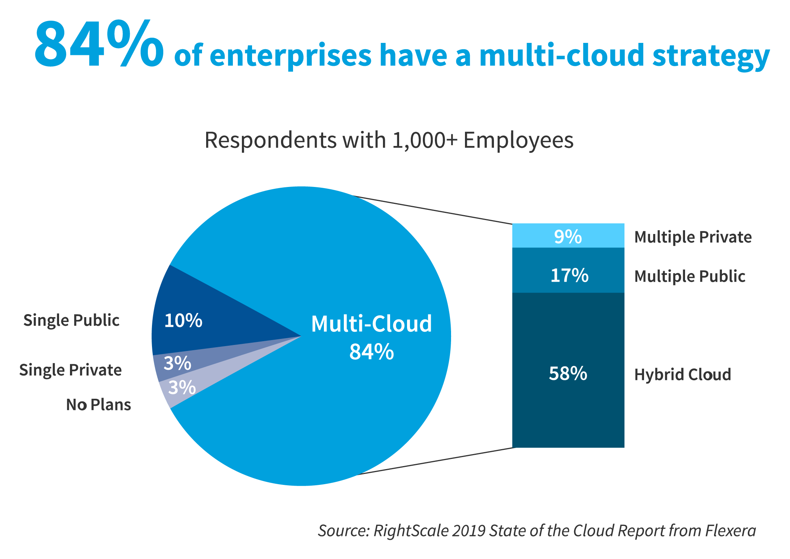

Slide 71
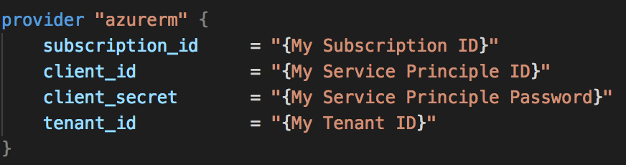
Azure Provider
Authentication
Azure CLI
Service Principal
MSI
Arguments
Environment Variables

